Slide 1
Investor Presentation
Nov 2011
Mr Weijun Yu
Mr Zhaoxing Tang
Mr Shiang-Peow Foo
Mr Richard Bennett

Slide 2
China New Energy Limited (AIM:CNEL)
A leading technology and engineering solutions provider in the design and construction of biofuel and biochemical production facilities.
An established company with excellent track record and strong business model
Inception since 2002
100 projects with aggregated implied production volume of 9.0 million tons of value RMB 1.7 billion
Strong, integrated and unique business model
Market leader in China with growing international presence
Directly or indirectly involved in more than 50% of China’s ethanol production capacity
Designed and constructed 60% of the incremental capacity of China’s ethanol production capacity over the last 3 years
Designed and constructed six bio butunol plants in China with aggregate capacity of 460,000 tons.
Completed overseas projects in Europe, S.E Asia and Taiwan successfully and growing international presence
Operates in a dynamic sector with excellent growth prospects
Biofuel is widely considered to be one of the key alternatives to fossil fuel use because of its renewable energy contents and clean emissions
According to McKinsey, Biofuel production capacity potentially to grow from the current 2 million tons per year to 31 m tons by 2020, bring in construction projects of close to US$14 billion in China
Conducts R&D on its own or in collaborations
Owns 22 patents
Developing cellulosic biofuel and biochemical
Profitable and growing
2010 Revenue of RMB 138m (2009: RMB 125m)
2010 Net profit of RMB 21m (2009: RMB 12m)
2
Notes:
2

Slide 3
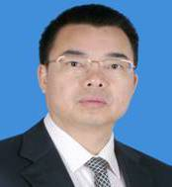
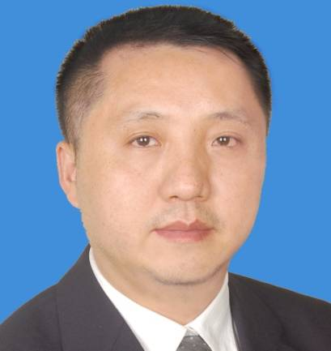
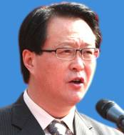
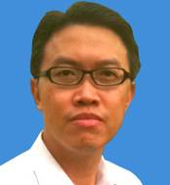
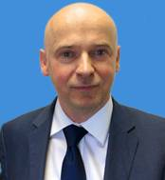
Board of Directors
YU Weijun (46) MBA, Executive Chairman Mr. Yu is the Chairman of CNE and ZKTY and is primarily in charge of the overall strategic planning and corporate development of CNE. Prior to joining CNE, he worked was Deputy Chief of GIEC CAS. Mr. Yu holds an Executive Master of Business Administration from Sun Yat-sen University and is a member of the Chinese Institute of Certified Public Accountants.
TANG Zhaoxing (41), BSc, MBA – Chief Executive Officer Mr Tang is the managing director of ZKTY. He is responsible for the overall company operation, sales and project design and management. Prior to joining ZKTY, he was managing director of GZTY Regeneration Resources , of which he is still a director. Mr. Tang graduated from South China Science & Tech University with a degree in Chemical Engineering, and holds an EMBA from Peking University.
Chen Yong (53) BSc, MSc, Ph.D. – Non-executive Director (independent) Mr. Chen is the President of Guangzhou Branch, Chinese Academy of Sciences. His major is researching in utilization of municipal solid wastes and management. He was a director of GIEC CAS from April 1998 to October 2006 and has been a Professor since October 1996.
FOO Shiang-Peow (40) MBA - Non-executive Director (not independent) Mr. Foo has many years’ investment and corporate finance experience. He is currently a director of NovusAsia Capital Limited. Mr. Foo started his career as an equity analyst in Salomon Brothers Inc, based in Singapore, in 1994 and has worked in Credit Suisse First Boston, UOB Asia Limited (part of the United Overseas Banking Group in Singapore) and BDO Raffles.
Richard BENNETT (43) - Non-executive Director (independent) Mr. Bennett started is career working for General Electric (GE) in Asia. He was a co-founder of J2 Inc. (NASDAQ:JCOM), and developed two businesses which have been admitted to the AIM market, VI plc and Coms plc (AIM:COMS). He is currently also a director of Jade Clean Technology Limited.
3

Slide 4
History
CNE Group of Companies officially incorporated
Secured Thail Ubon Project in Northern Thailand
Predecessor company formed and secured its first major contract
Secured a contract with Indonesia Fuel Ethanol Co. Limited
Awarded the first in a series of contracts by Jilin Meihekou Foukang Alcohol Co., Ltd to increase its production of edible ethanol by 35,000 tonnes per year.
ZKTY was awarded ISO 9001:2000 certification
Technology and engineering solution provider to Jilin Alcohol Industry Co. Ltd.
ISO9001:2000 and CE accreditation
2002
2003
2006
2007
2008
2009
2011
Beyond
2012
ZKTY secured contracts with further international clients, including the Blagoveshchensk Alcohol Plant in Russia and clients in Taiwan and Thailand
Fully Integrated Business Offering
ZKTY secured its first contract in Europe to provide design and construction services for the production of a 80,000 tonnes per year fuel ethanol plant in Romania
Listed on AIM, LSE

Slide 5
Business Model Overview
Integrated technology and engineering solution provider to biofuel and biochemical producers
CNE
AIM quoted, Jersey incorporated, Group holding company
Guangdong Zhongke Tianyuan New Energy Science & Technology Co. Ltd (“ZKTY”)
Wholly foreign owned enterprise and trading entity
Technology and Engineering
Investments
Design and Build
Energy Management Conservation (“EMC”) and Yeast Management Services
Waste Management
Research and Development
Acquisitions and Joint Ventures
5
5

Slide 6
Primary Market Drivers and Opportunities
Drivers
Opportunities
Peak Oil
Bioenergy is widely considered to be one of the key alternatives to fossil fuel
Mandatory blending around the world (including China) – e.g. 10% of road fuels in the EU by 2020
National Development and Reform Commission in China forecasts that the production of ethanol will increase from 1.7m tons in 2008 to 10m tons in 2020
“Fuel versus fuel”
Novozymes and Mckinsey & Company predict that cellulosic ethanol could be substituted for 31m tons of gasoline in China by 2020, cutting the nation's oil imports by 10%, and forecasted to bring about construction projects with a total value of RMB 96bn between 2010 to 2020.
Energy Security
Climate Change

Slide 7
Secondary Market Drivers and Opportunities
Drivers
Opportunities
China GDP Growth
Growth in alcoholic beverages industry and chemical industry in China leading to greater demand for bio-ethanol and bio butanol.
Focus on improving efficiency and profitability of many domestic producers
Improve production yield
Reduce energy use
Efficiency and Profitability

Slide 8
Technology and Engineering
Organic Feedstock:
Starch (corn, cassava);
Sugar;
Cellulosic
Bio-ethanol;
Bio-butanol;
Others
Pretreatment
Fermentation
Distillation
Dehydration
Waste
Treatment
8
Technology and engineering solution provider to bio-ethanol and bio-butanol production facilities
Business offerings meet customers needs across the full life cycle of production – from feedstock technology to waste recovery
Market dominance in China –
60% share of the incremental capacity since 2007
50% of China’s bio-ethanol and bio-butanol production capacity

Slide 9
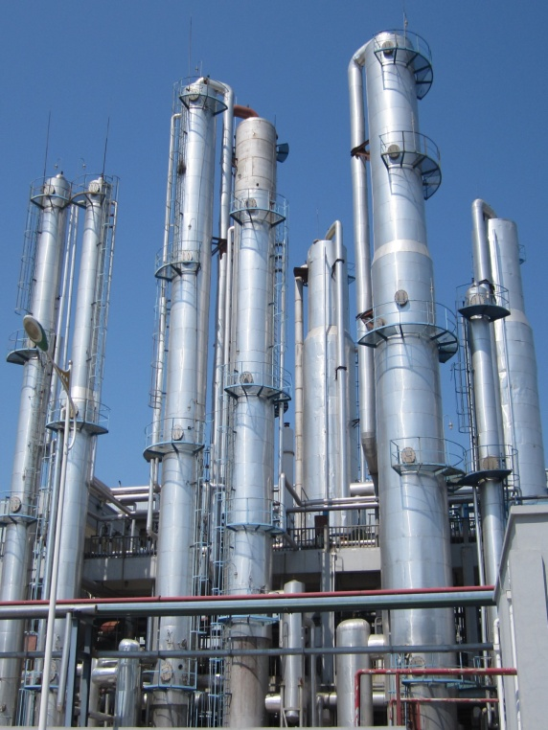
Business Model – Design and Build
Broad design and engineering, operational and project management skills in the design and construction of biofuel and bio chemical production facilities
Business offerings:
Technical design and engineering.
Procurement and construction.
Installation and testing.
Training of customers’ staff.
Maintenance
Upgradation
ISO 9001:2000 and CE accreditation
Completed projects in Russia, Romania, Taiwan, Indonesia and Thailand
Designed an constructed the first bio-butanol plant in China
Designed and constructed the largest bio-butanol plant in China
9

Slide 10
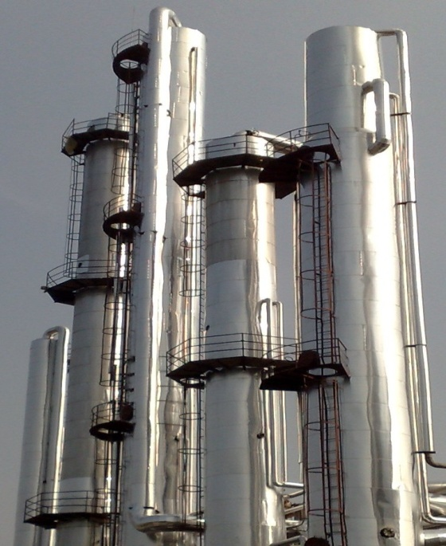
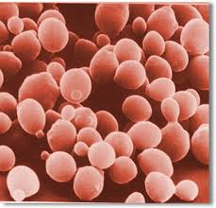
Business Model – EMC and Yeast Management
Deployment of capabilities to help customers create more value by reducing the energy consumption (“Energy Management Conservation” or “EMC”) and Yeast Management Services,
EMC
Modifying the customer’s existing equipment and/or installing ancillary equipment for the customer’s existing production infrastructure. Under the model, the Group bears the costs of modifying the customer’s existing equipment and installing ancillary equipment in return for a share of the customer's targeted net energy saving.
Completed project with Yichang Sanxia Limin Biochemical Ltd. In 2009
Costs of modifying RMB4 million
RMB200,000 per months x 60 months
Yeast Management and Supply Services NEW BUSINESS INITIATIVE
Yeast, format, handling, technical service and training to effectively and economically reach maximum production and profitability
Supply “liquid yeast” onsite
Facility added on to customer’s existing production facility to reduce the amount of steam consumption in ethanol production
Recurring cash flow and high margins
Image of Yeast
10

Slide 11
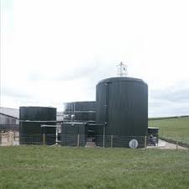
Business Model – Waste Management
The Group helps customers to recover and treat waste water into biogas.
Biogas refers to either a methane, hydrogen or carbon dioxide rich gas that is produced as organic matter breaks down.
Plants can supply and sell clean biogas as fuel for civilian use to the local utility gas companies.
The Group specializes in the production of biogas through the treatment and anaerobic fermentation of waste by-products from the ethanol production process.
Pilot projects:
An agreement with Dongguan Xin’ao Gas Co. Ltd, to design and construct a bio-gas recovery and purifying plant at a beer brewery located in Dongguan China.
An agreement to design and build a bio-gas recovery and purifying plant at a beer brewery owned by Kingway Beer Group, located in Shenzhen China, with the intention that the purified biogas be sold to Shenzhen City Gas Group.
11

Slide 12
Business Model – Investments
Research &
Development
Continue enhancement of production yields and reduction of energy consumption;
Developing and commercializing new sources of biofuel and biochemicals through internal research efforts and via joint collaborations with third parties
The Company has developed proprietary technology of producing bio-butanol using cellulosic materials (agricultural waste). This process allows us to efficiently capture all co- and by products (Acetone, Butanol and Ethanol [or commonly known as “ABE”], and biogases) produced during the process thereby maximizing the value extracts from inputs. At the moment, based on laboratory settings, our unit cost of bio-butanol is around RMB8,500 – RMB9,000 per ton versus the current market price of butunol of around RMB10,000 per ton. We are working towards reducing the unit production cost further to RMB7,500-8,000 per ton over the next 12 months.
Research collaborations with
Butylfuel LLC;
Green Biologic Limited;
Ji’nan University
Joint Ventures &
Acquisitions
To form joint ventures to commercialize R&D;
To acquire and transform undervalued plants into profitable bio-refineries
12

Slide 13
Growth Strategy
Expand customer base and enlarge geographical market.
Leverage its leading market position to expand its capability to capture and maintain its market share in the China bio-ethanol and bio-butanol market.
Broaden its international presence by marketing its services globally, especially in Southeast Asia.
Expand EMC business and developing new complementary services such as Yeast Management.
Expand its existing service offering by further developing its engineering capabilities.
Develop and commercialize new sources of biofuel and bio-chemical through internal research efforts, and via joint collaborations with third parties.
Carry out further research and development in the areas of biofuel production.
Develop new processes to maximise the extraction of ethanol and other biogases from cassava.
To commercial cellulosic ABE production technology
Achieve growth through acquisitions, joint ventures or strategic alliances:
Expand its capabilities and business through acquisitions, joint ventures or strategic alliances.
Explore opportunities to acquire other operations which are also involved in similar industries.

Slide 14
Group Financial Snapshot
 | Year ended 31 December 2007 RMB’000 Audited | Year ended 31 December 2008 RMB’000 Audited | Year ended 31 December 2009 RMB’000 Audited | Year ended 31 December 2010 RMB’000 Unaudited
Revenue | 205,749 | 224,208 | 125,301 | 138,359
Revenue Growth (%) | N/A | 9% | -44% | 10%
Gross profit | 41,802 | 42,080 | 31,520 | 40,228
Gross Margin (%) | 20% | 19% | 25% | 29%
Other operating income | 1,079 | 4,587 | 5,563 | 464
Total Operating expenses | (55,696) | (52,834) | (19,820) | (17,030)
Interest expenses | (1,045) | (9,622) | (2,837) | -
Income tax expense | (9) | (8) | (2,508) | (3,623)
Profit/(loss) for the financial year/period | (13,869) | (15,797) | 11,918 | 20,039
Net margin (%) | -7% | -7% | 10% | 14%
 | As at 31 December 2007 RMB’000 Audited | As at 31 December 2008 RMB’000 Audited | As at 31 December 2009 RMB’000 Audited | As at 31 December 2009 RMB’000 Unaudited
Total Assets | 255,129 | 127,298 | 152,441 | 176,049
Total Liabilities | 252,180 | 137,980 | 156,703 | 156,776
Net assets/(liabilities) | 2,949 | (10,682) | (4,262) | 19,273

Slide 15
ZKTY - trading updates
(RMB) | 9 months ended 30 Sept 2010 |  | 9 months ended 30 Sept 2011 | % change
New contracts secured | 90 million |  | 180 million | 100%
Revenue | 84,947,825 |  | 101,713,422 | 20%
Cost of sales | 60,862,019 |  | 80,200,964 | 32%
Gross profit | 24,085,806 |  | 21,512,458 | -11%
Gross margins | 28.4% |  | 21.2%
Other operating income | 660,822 |  | 4,221,872 | 539%
Distribution costs | 2,090,128 |  | 2,186,258 | 5%
Administration expenses | 6,340,856 |  | 5,718,519 | -10%
Other operating expenses | 582,272 |  | 1,474,320 | 153%
Profit from operations | 15,733,374 |  | 16,355,234 | 4%
Financial expenses | - |  | 820,721
Profit before tax | 15,733,374 |  | 15,534,514 | -1%

Slide 16
Outlook and prospects
Technology and engineering solutions provider to Jilin Alcohol Industrial Co. Ltd (“JAIC”)
A group with annual corn processing capacity of 2 million tons, annual ethanol production capacity of 600,000 tons, and management control over annual production capacity of 500,000 tons biofuel grade ethanol.
JAIC is targeting to increase the annual production of ethanol to 1,000,000 tons production capacity by 2012-2013.
ZKTY expects to
generate recurring revenue stream from provision of high margins products and services in EMC, Yeast Formulation and Management and biogases;
participate in the capital expenditure contracts to increase JAIC capacity (either by way of modification of existing facilities or construction of new facilities);
be given a platform to collaborate on ZKTY's technology initiatives of producing ABE using cellulosic materials; and
be given a platform to demonstrate our integrated business model and our strength to scale up and duplicate our business elsewhere in China and around the world.

Slide 17
Outlook and prospects
Major projects in negotiation

Slide 18
Business and Corporate Development Goals
Business
CAGR of no less than 30% annually in 2011 to 2013
Continue focus on cash flow
Cost control
Sustainable and recurring income
Continue focus on R&D
Mergers and Acquisitions
Corporate
Raise Company profile and presence internationally
Improve IR
Increase and broaden shareholders base, especially institutional investors

Slide 19
Summary
Excellent industry growth prospects
Market leader in China with growing presence internationally
Unique and proven business model driven by a strong management and experience Board
Research and development capabilities
Profitable and growing
19

Slide 20
Use of proceeds
CNE intends to raise ￡5 million and beyond* gross pursuant to a placing of new shares (the “Placing”)
Use of net proceeds
To provide the business with additional working capital (c. 40% of net proceeds)
To fund the expansion of EMC/yeast management & supply/waste management (c. 40% of the net proceeds)
To fund research & development activities (c. 30% of the net proceeds)
(* In the event we raise more than ￡5 million at the Placing, CNE will retire the entire outstanding amount due to Citadel immediately. )
20

Slide 21
Thank You

Slide 22
Group Structure and Background
AIM quoted, Jersey incorporated, Group holding company
CNE
(Jersey incorporated and admitted to AIM)
company
CNE
(Jersey incorporated and admitted to AIM)
Overseas
100%
China
Wholly foreign owned enterprise and trading entity
Guangdong Zhongke Tianyuan New Energy Science & Technology Co. Ltd.
(“ZKTY”)
100%
Technology engineering
Engineering
Guangdong Boluo Jiuneng High New Technology Engineering Co., Ltd. (“Boluo”)
22

Slide 23

Contact Information
China New Energy Limited
Queensway House
Hilgrove Street
St Helier
Jersey
JE1 1ES
Channel Islands
Web www.ChinaNewEnergy.co.uk
EPIC CNEL
ISIN JE00B3RWLF12
ZKTY
8F Technology Integration Building of GIEC
4 Nengyuan Road
Wushan
Tianhe District
Guangzhou
China
Web www.zkty.com.cn
Mr Weijun YU (Chairman)
yuwj@zkty.com.cn
 +86 139 0306 6479
Mr Zhaoxing TANG (CEO)
tangzx@zkty.com.cn
 +86 186 2000 6622
Mr Shiang-Peow FOO (NED)
shiangpeow@zkty.com.cn
 +65 9623 8948
Mr Richard BENNETT (NED)
rbennett@zkty.com.cn
+44 (0)7966 388 374
23

Slide 24
Important Notice
The information contained in this Presentation has been prepared by China New Energy Limited (the “Company”). This Presentation and its contents are for distribution in the United Kingdom only to persons of the kinds described in Articles 19(5) (investment professionals), 48 (certified high net worth individuals), 49(2) (high net worth companies), 50 (sophisticated investors) or 50A (self-certified sophisticated investors) of the Financial Services and Markets Act 2000 (Financial Promotion) Order 2005 (as amended) (the “Order”) and persons who are otherwise permitted by law to receive it. It is not intended to be distributed or passed on, directly or indirectly, to any other class of persons. Persons of any other description, including those who do not have such experience in matters relating to investments, should not rely on this Presentation or act upon its content. By accepting this Presentation and not immediately returning it, the recipient represents and warrants that they are a person who falls within the above description of persons entitled to receive the Presentation.
The information contained in this presentation has been prepared by the Company in connection with the proposed placing of securities in the Company. This presentation is being supplied to you solely for your information and may not be reproduced or redistributed, in whole or in part, to any other person, or published, in whole or in part, for any purpose.
This presentation and its contents are for distribution to persons or entities resident in the United Kingdom only. It is not intended to be distributed or passed on, directly or indirectly, to persons or entities resident outside of these jurisdictions. Persons of any other description, including those who do not have such experience in matters relating to investments, should not rely on this presentation or act upon its contents.
This presentation and its contents are confidential. It is being supplied to you solely for your information and may not be copied, reproduced or further distributed to any other person or published in whole or in part, for any purpose.
This presentation may be incomplete or condensed and it may not contain all material information concerning the Company. The information in this presentation may be subject to updating, revision, amendment and further verification.
The information in this presentation does not constitute, or form part of, any offer or invitation to sell or issue, or any solicitation of an offer or invitation to purchase or subscribe for, any shares in the Company nor shall this presentation, or any part of it, or the fact of its distribution, form the basis of, or be relied on, in connection with any contract.
Certain statements throughout this presentation are "forward-looking statements" and represent the Company's projections, intentions, expectations, estimates or beliefs concerning, among other things, future operating results and various components thereof or the Company's future economic performance. The projections, intentions, expectations, estimates and beliefs contained in such forward-looking statements necessarily involve known and unknown risks and uncertainties which may cause the Company's actual performance and financial results in future periods to differ materially from any projections, intentions, expectations, estimates or beliefs. Accordingly, you should not rely on any forward-looking statements and the Company accepts no obligation to disseminate any updates or revisions to such forward-looking statements.
The Company and the directors of the Company accept responsibility for the information contained in this presentation and to the best of their knowledge and belief such information is true and does not omit anything likely to affect the import thereof.
Recipients of this presentation who intend to participate in the proposed placing are reminded that no reliance may be placed by any person for any purpose whatsoever on the information contained in this presentation or on its completeness, accuracy or fairness. No representation or warranty, express or implied, is given by or on behalf of the Company, SVS Securities plc or their respective shareholders, directors, officers or employees or any other person as to the completeness, accuracy or fairness of the information or opinions contained in the presentation and the accompanying verbal presentation, and no liability is accepted for any such information or opinions (including in the case of negligence, but excluding any liability for fraud).
The distribution of the document containing this presentation in certain jurisdictions may be restricted by law and therefore persons into whose possession the document comes should inform themselves about and observe any such restrictions. Any such distribution could result in a violation of the law of such jurisdictions. Neither the document nor any copy of it may be distributed, reproduced, transmitted or otherwise made available in whole or in part to persons in the United States of America, Canada, Malaysia, Japan, Australia, the Republic of Ireland or the Republic of South Africa or to any corporation, partnership or other entity created or organised under the laws thereof. No securities commission or similar authority in Canada has in any way passed on the merits of the securities offered hereunder and any representation to the contrary is an offence. No document in relation to the proposed placing has been, or will be, lodged with, or registered by, The Australian Securities and Investments Commission, and no registration statement has been, or will be, filed with the Japanese Ministry of Finance in relation to the placing or the securities described in this presentation. Accordingly, subject to certain exceptions, the securities described in this presentation may not, directly or indirectly, be offered or sold within Canada, Malaysia, Japan, Australia, the Republic of Ireland or the Republic of South Africa or offered or sold to a resident of Canada, Malaysia, Japan, Australia, the Republic of Ireland or the Republic of South Africa.
The securities described in this presentation have not been, and will not be, registered under the United States Securities Act of 1933, as amended (the “US Securities Act”) or with any securities regulatory authority of any state or other jurisdiction of the United States of America and may not be offered or sold within the United States of America or to, or for the account or benefit of, any US Person as that term is defined in Regulation S under the US Securities Act. The Company has not been registered and will not register under the United States Investment Company Act of 1940, as amended.
This presentation contains information about the historical financial performance of the Company and its subsidiaries from time to time (the “Group” or “CNE”). Past performance is not, however, a guarantee or reliable guide as to the future financial performance of the Group.
24

